Slide 1
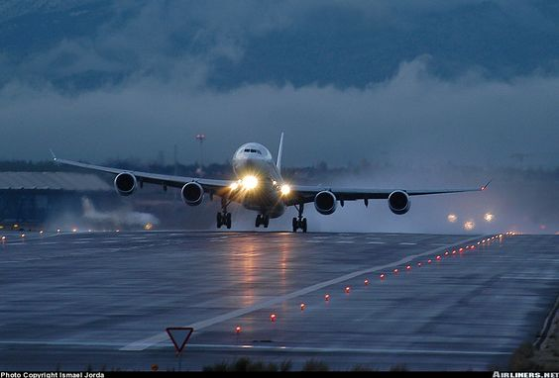
FLIGHT FARE PREDICTION MODEL
RBA 2020-22
GROUP 10
Jidnyasa Heda 20
Ruchika Dhamane 41
Shivani Bihade 49
Vishal Malpure 58

Slide 2
Flight ticket prices can be something hard to guess, today we might see a price, check out the price of the same flight tomorrow, it will be a different story. We might have often heard travelers saying that flight ticket prices are so unpredictable. Hence, we have built a model to predict the prices of flight tickets for various airlines between the months of March and June of 2019 and between various cities. Size of training set: 10,683 records.
PROJECT INTRODUCTION
The flight ticket price in India is based on demand and supply model with few restrictions on pricing from regulatory bodies. It is often perceived as unpredictable and, recent dynamic pricing scheme added to the confusion. The objective is to create a machine learning model for predicting the flight price, based on historical data, which can be used for reference price for customers as well as airline service providers.
OBJECTIVE

Slide 3
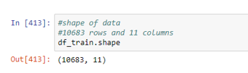
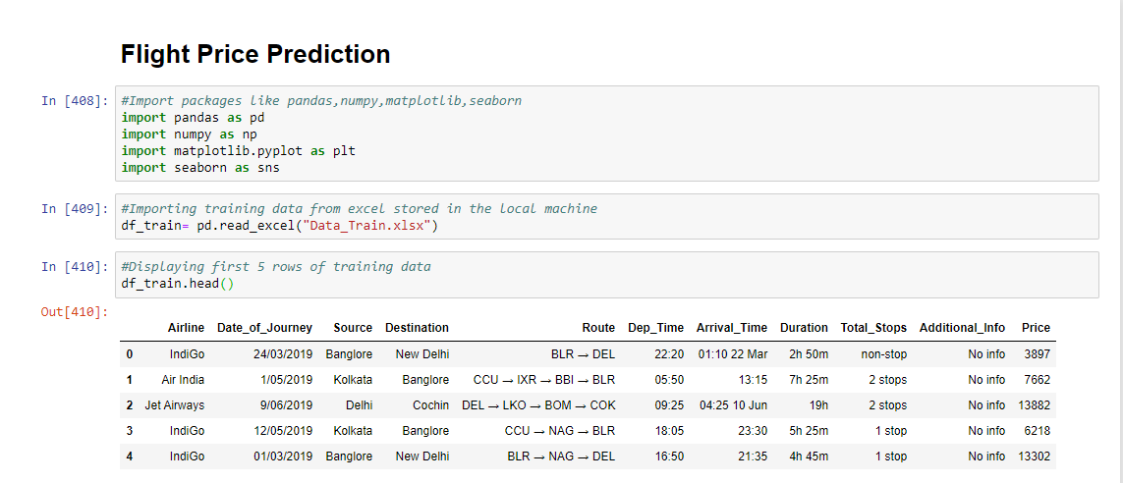
EXPLORATORY DATA ANALYSIS
STEPS FOLLOWED FOR PRE-PROCESSING IN PYTHON
Import Library
Data summary
Data Visualization
Checking null values
Conversion of categorical to numerical values.
a. One-hot encoding (nominal data)
b. Label encoding (ordinal data)
Correlation Matrix
Data frame export to csv
Snapshot of sample data

Slide 4
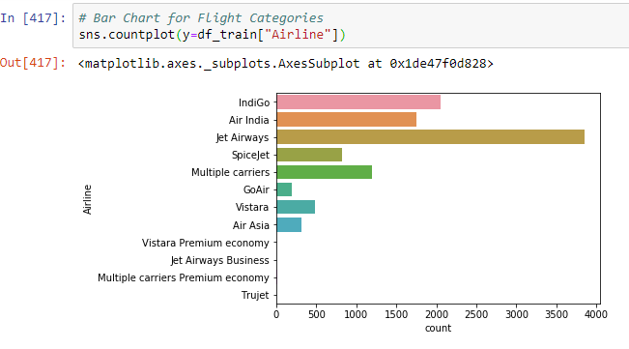
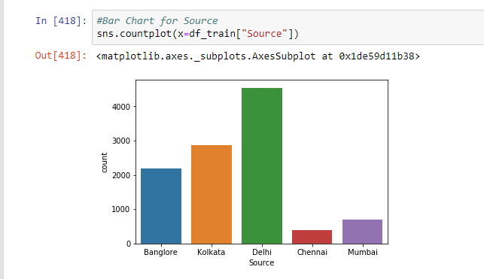
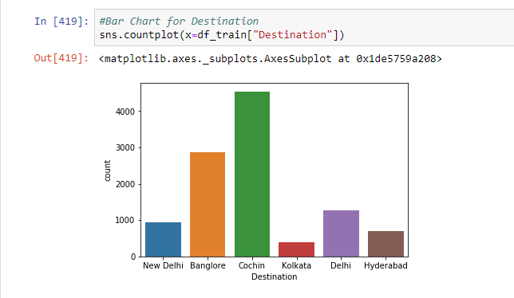
DATA VISUALIZATION
Count Plot of Airlines
Count Plot of Source
Count Plot of Destination

Slide 5
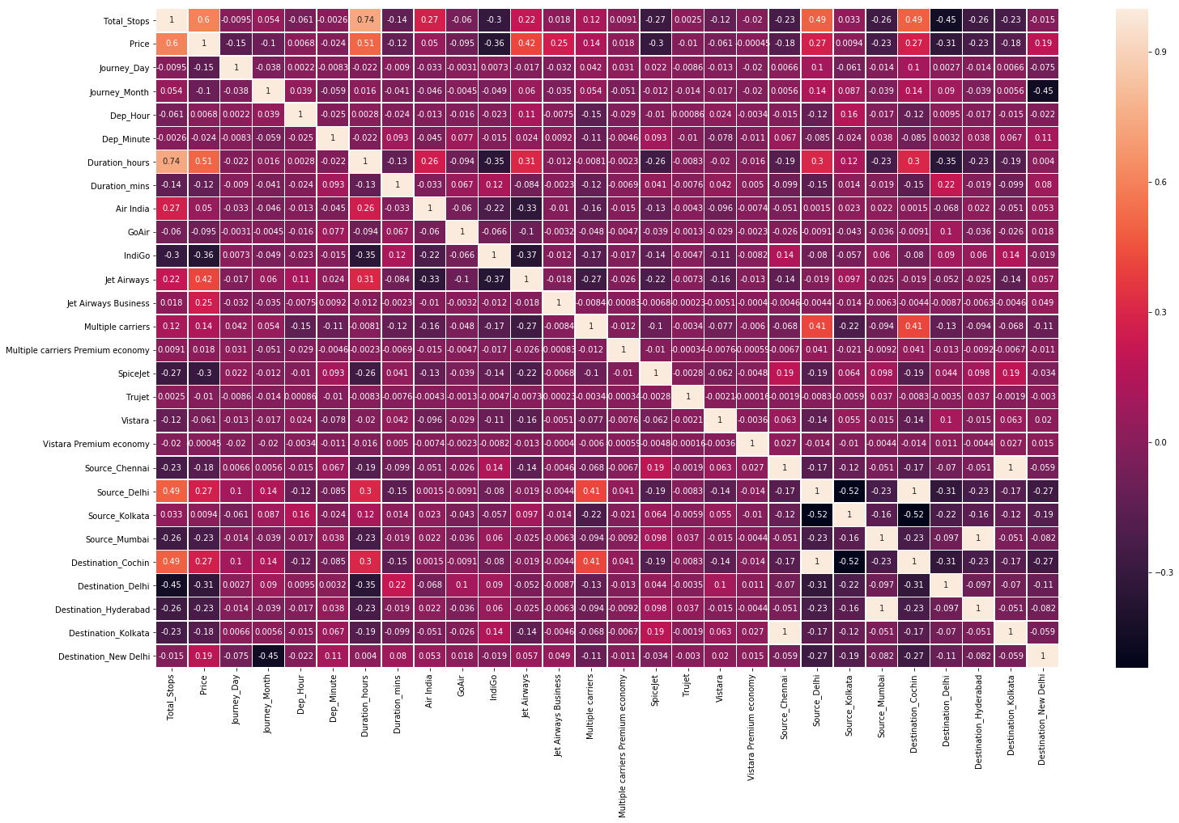
Correlation Matrix
Source Chennai- Destination Kolkata
Source Mumbai – Destination Hyderabad
Destination Cochin-Source Delhi

Slide 6
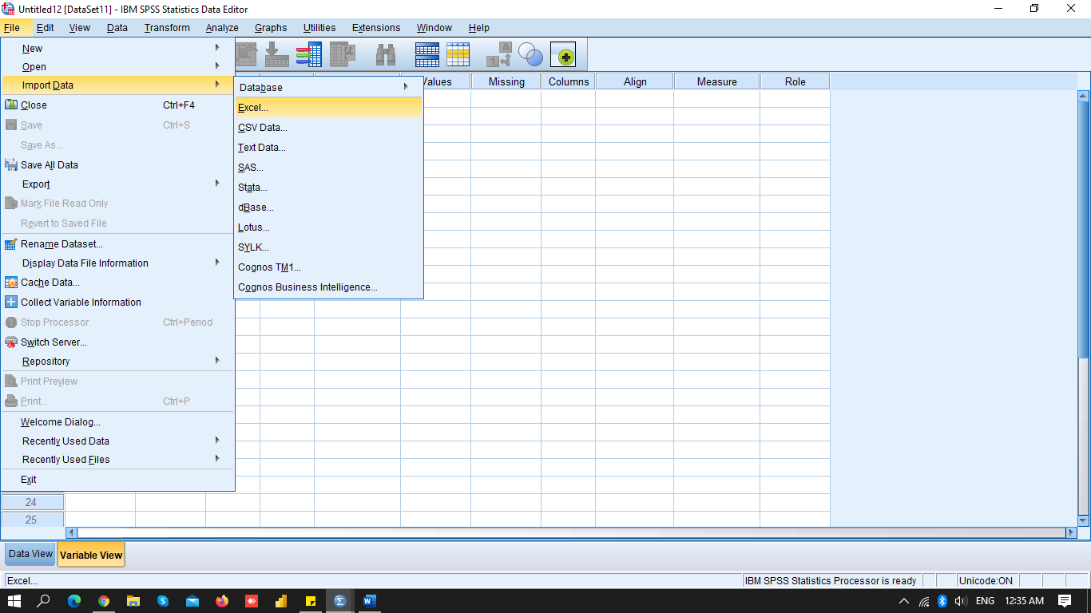
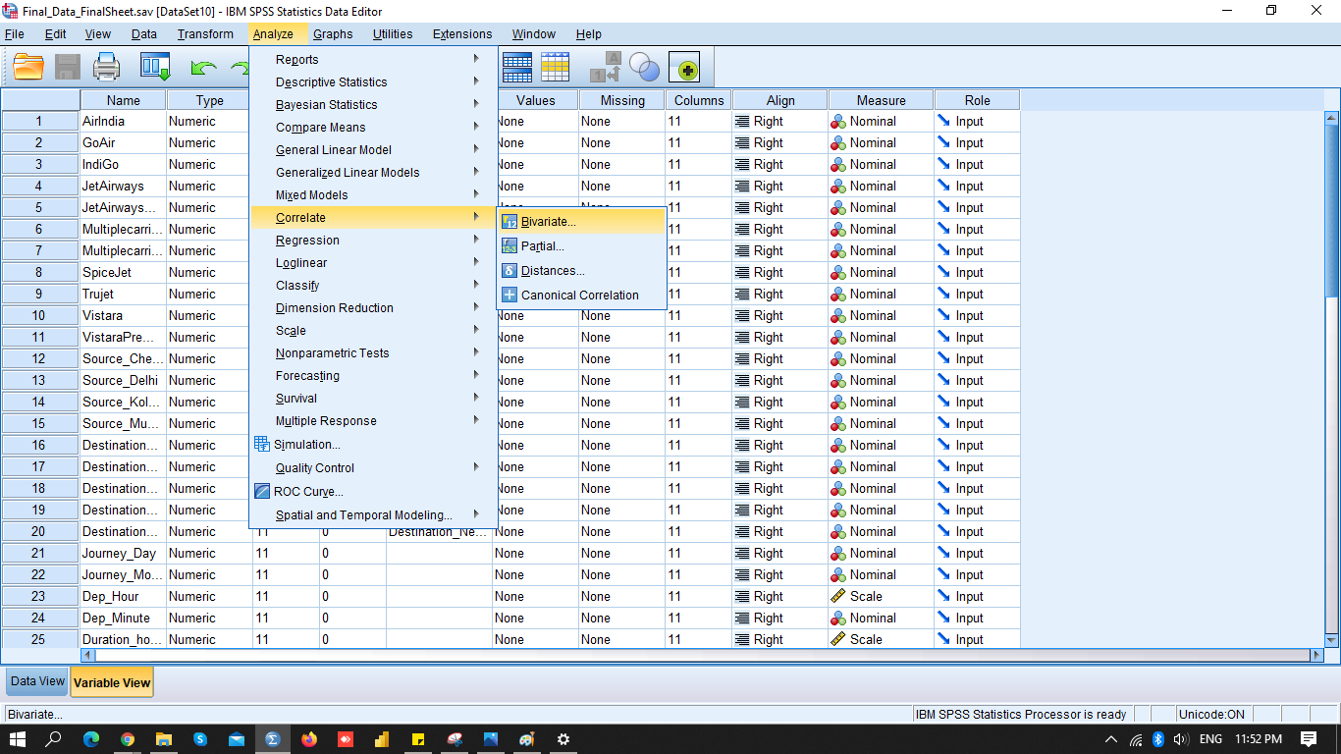
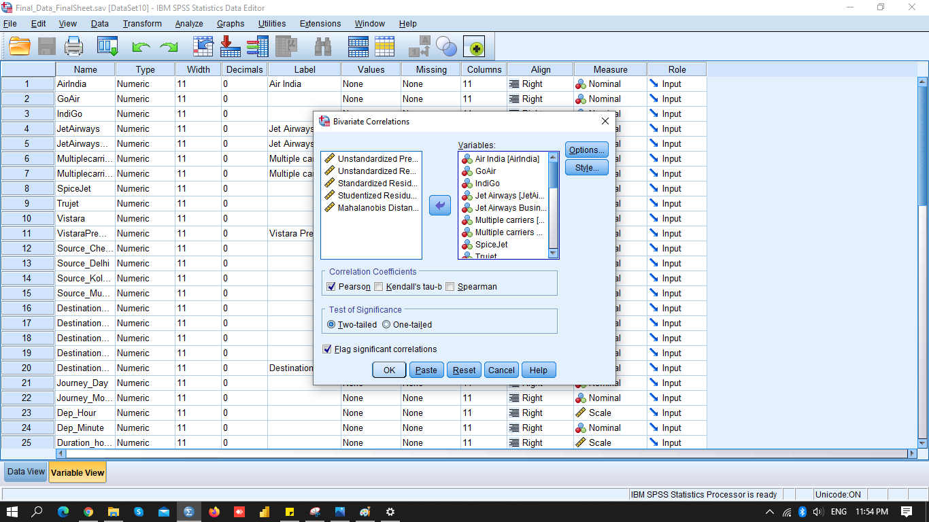
MODEL BUILDING AND RESULTS

Slide 7
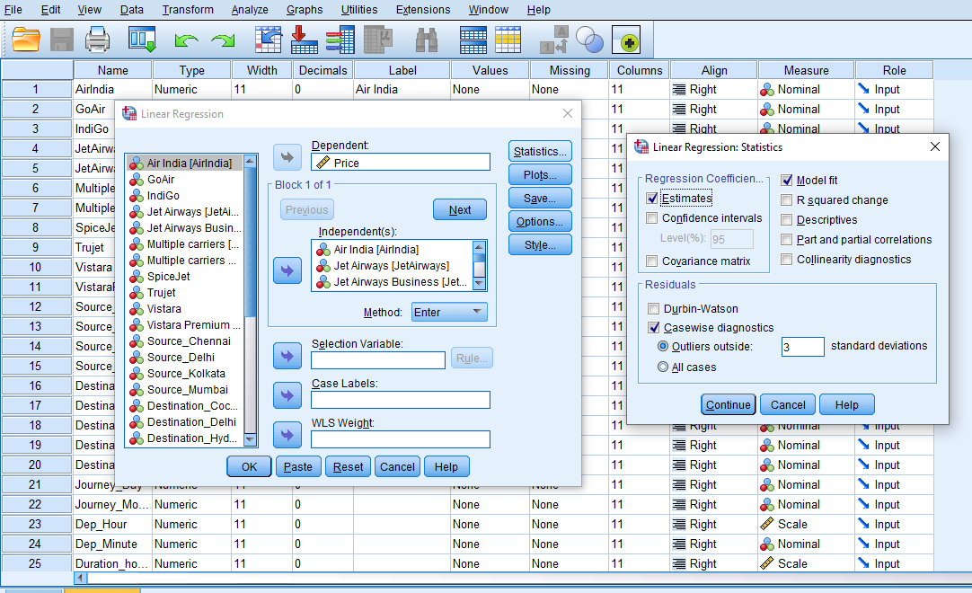
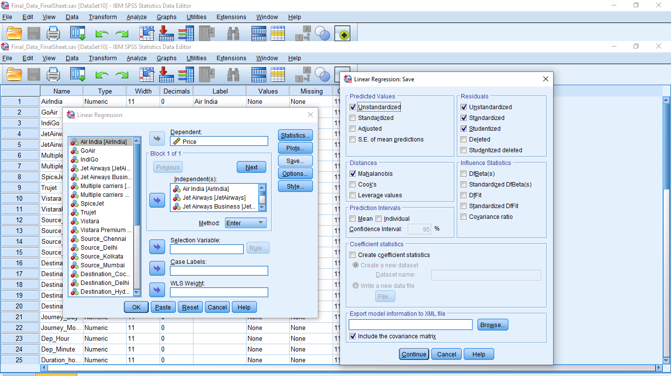
MODEL BUILDING AND RESULTS

Slide 8
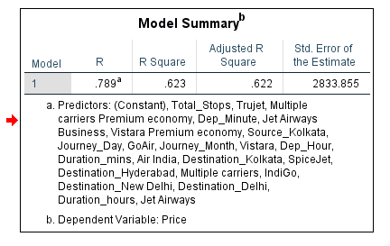
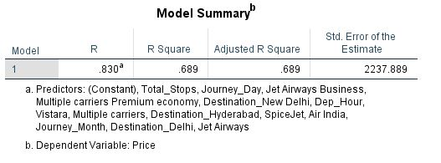
INTERPRETATION
Fig. 1: Before Processing
Fig. 2: After Processing
R square value = 62.3%
R square value = 68.9 %

Slide 9
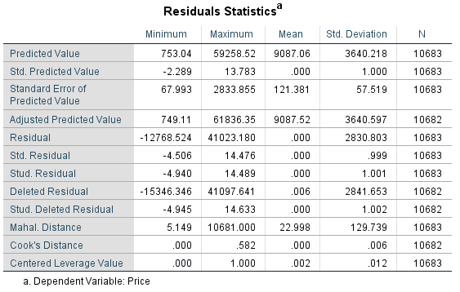
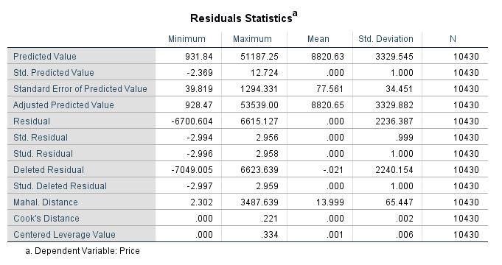
Analysis of Residual Statistics
Fig. 3: Before Processing
Fig. 4: After Processing
Stud Residual value lies between -4.940 to 14.489
Stud Residual value lies between -2.996 to 2.956

Slide 10
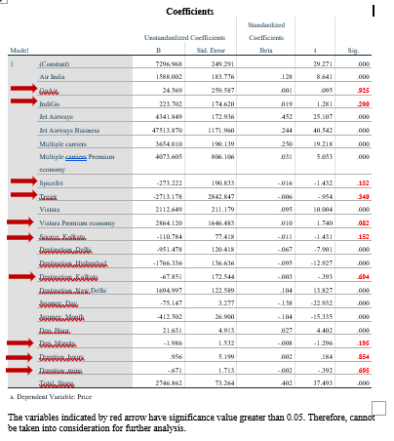
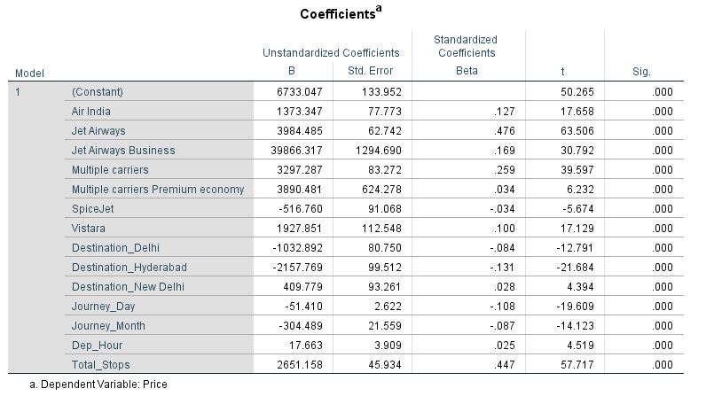
Analysis of Significance value of Independent variables
Fig. 5: Before Processing
Fig. 6: After Processing

Slide 11
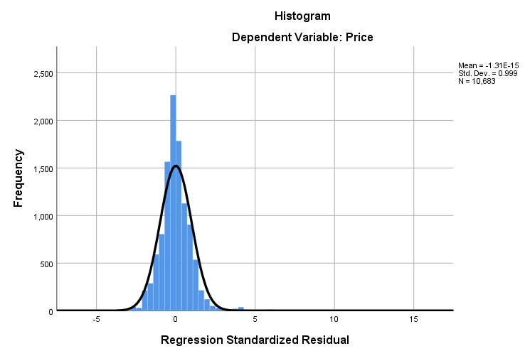
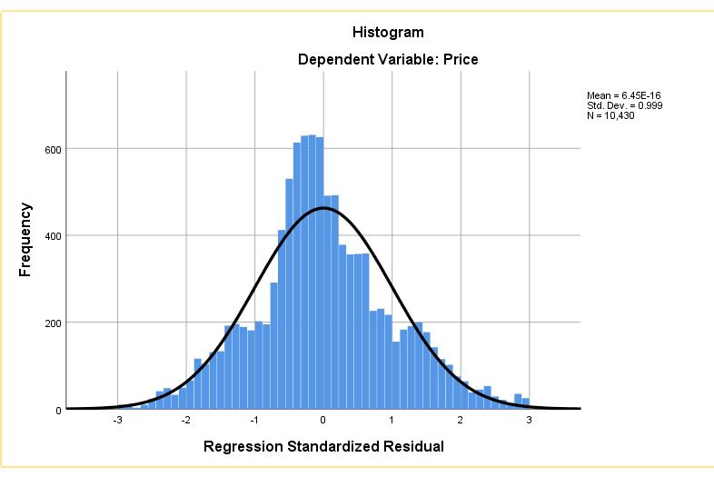
Analysis of Normality curve
Fig. 7: Before Processing
Fig. 8 After Processing

Slide 12
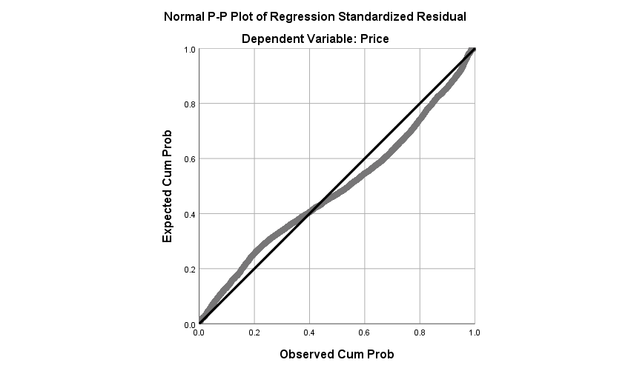
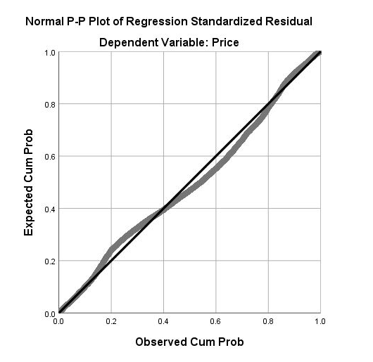
Analysis of P-P Plot
Fig. 9: Before Processing
Fig. 10 After Processing

Slide 13
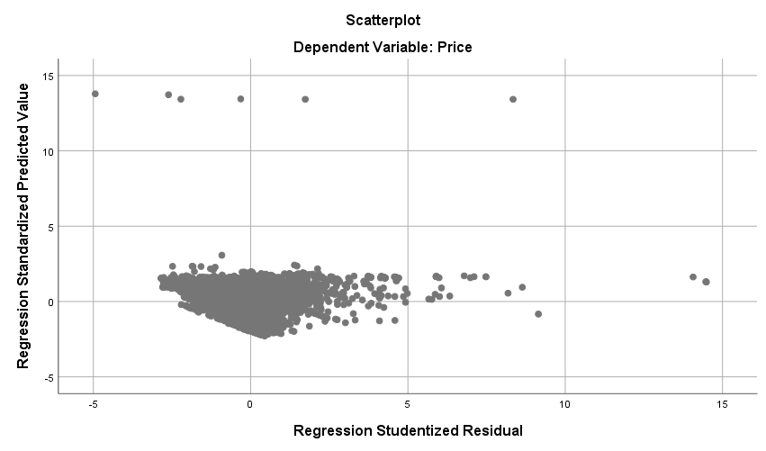
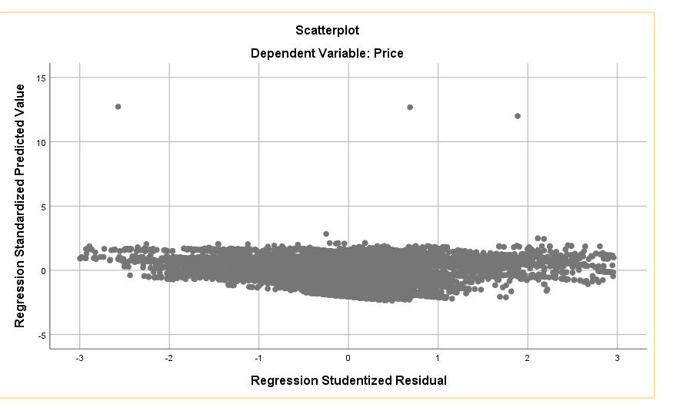
Analysis of Scatter Plot
Fig. 11: Before Processing
Fig. 12: After Processing

Slide 14
CONCLUSION
Final model after removing the outliers showed an improvement in R square to 68.9 %.
Homoscedasticity is achieved
P-P plot showed improvement
Residual normality is achieved
FUTURE SCOPE
We can deploy this model on AWS or GCP and build a web application wherein the users can enter the basic information(Journey Date, Source, Destination, Number of stops) and get the flight price on button click.
Retraining approach : Generating pickle file after every month to increase the accuracy and R-Square

Slide 15
THANK YOU!

